Slide 1
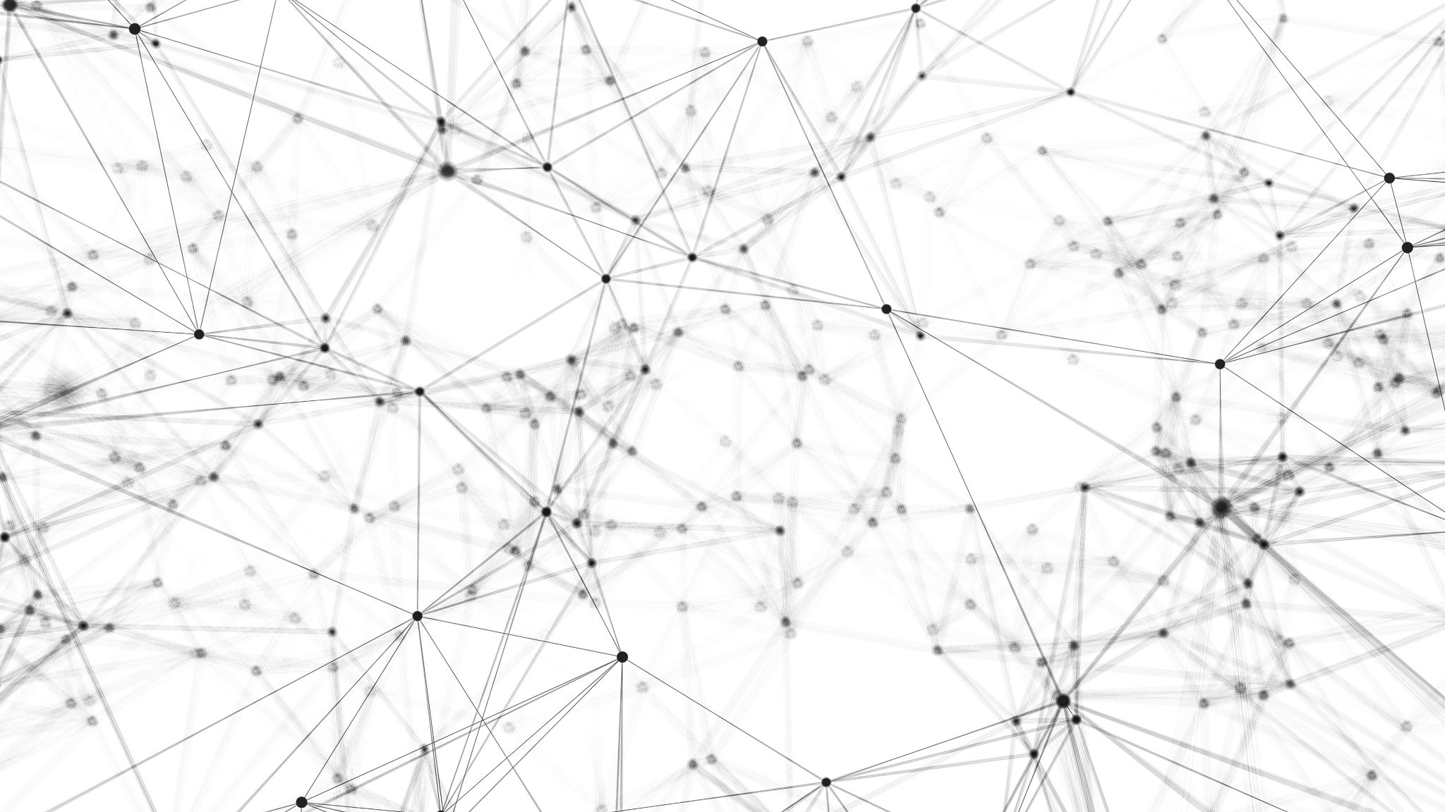
Uml diagram
Eng: Rafa Saif

Slide 2
01 Class diagram
customer
The name of the customer. Customer arrival time and customer exit time. Service counter mode.
Restrictions (End of Service). Input (Name - Time - Counter)
Evaluation for administrator
Best and wors time. Rating the service counter from best to worst. Rating type (good - bad).
A certain time of work has passed, or a certain number of clients has passed
Robot task
Attract customers' attention. Register customer information. Customer question + save customer information within the system.
Customer evaluation.

Slide 3


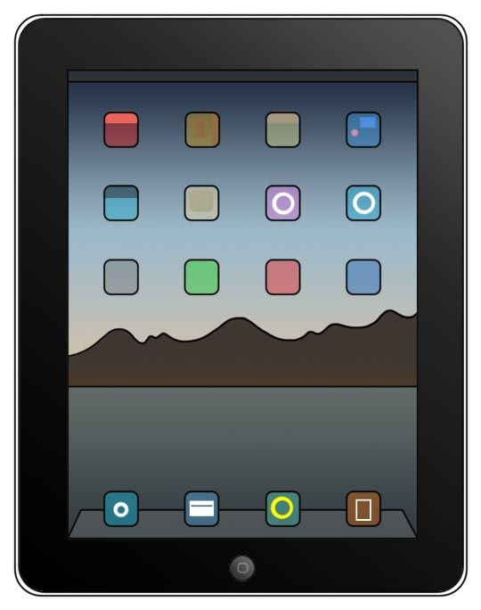



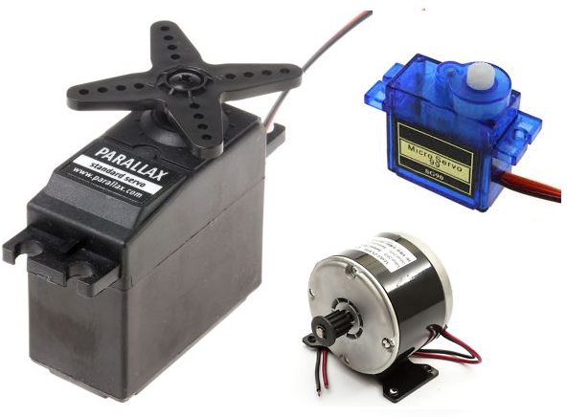
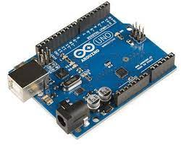
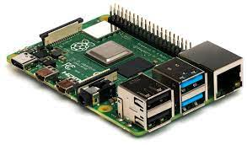
02 Deployment Diagram

Slide 4



03 Use case diagram
Run the Robot
Ask questions
Answer & interaction
Positive
Negetive
Hand movment
Servece evaluation
Off the Robot

